Slide 1



Wolters Kluwer: HEalth - Language model
AI-powered differential diagnosis support for faster, more accurate clinical decision-making
30th April, 2025
Presenters: Anidya Singh Bhandari, Anish Saha, Haijun Zeng, Nikhita Shankar, Shaoyang Sun

Slide 2
01
Company & Project Introduction
02
Business Problem & Its Importance
03
Project Framework
Agenda Overview
04
Technical Problem Statement
05
Data Overview
06
Solution Walkthrough
07
Challenges & Learnings
08
Future Recommendation

Slide 3

Introduction
Company:
A $40B global leader in professional information and software solutions, serving millions of customers across 180 countries.
Project Scope:
Research exploration on using Large Language Models (LLMs) for differential diagnosis support.
Strategic Importance:
Advances research into applying LLMs for real-world healthcare challenges.
Supports Wolters Kluwer’s long-term goal of improving diagnostic accuracy without immediate commercial constraints.

Slide 4
Business Problem & Its Importance
Core Business Problem:
Can LLMs assist clinicians by generating accurate differential diagnoses from patient case data?
Why It Matters:
Addresses diagnostic errors and improves early identification of critical conditions.
Potential for cost reduction, better patient outcomes, and faster decision-making.
Success Criteria:
High accuracy in differential diagnosis suggestions (Top-3/Top-10 ranking).
Effective handling of varying case formats (short excerpts, full histories, simulated conversations).

Slide 5

Project Framework: Overview
​
Data Strategy
& Prompt Design​
Model Testing
& Evaluation​
Prototype & Recommendations
Scoping
& Planning
Align with Wolters Kluwer on project
vision
Run experiments using different LLM
Curate NEJM patient case reports
Build Streamlit-based prototype
Identify LLMs for differential diagnosis
Structure inputs using JSON format
Test model parameters
Present ranked
diagnoses
Measure diagnosis ranking performance
Define evaluation metrics
Design prompt templates
Recommend
future enhancements

Slide 6
Technical Problem Statement
Technical Challenge:
Adapt LLMs for clinical decision-making using structured and semi-structured patient data.
Success Metrics:
Mean Reciprocal Rank (MRR) and Discounted Cumulative Gain (DCG) for diagnosis ranking.
Reduction in hallucinations (incorrect outputs) by tuning model parameters (e.g., temperature).

Slide 7

Data Overview
Data Sources
Data Processing
Development Stack
25 NEJM (New England Journal of Medicine) case reports (late 2024–early 2025).
Extracted patient histories into different formats: short, full-length, and simulated dialogues.
Text cleanup, prompt engineering, simulated ambient listening.
OpenAI ChatGPT-4o APIs, Google Gemini 2.5 Pro APIs.
Python (Streamlit for prototype).
Collaborative notebooks for model experimentation.

Slide 8
Solution Walkthrough
Prompt Structures
Model Evaluation
Prototype Development
“Atom of thought” prompting: include context, goal, warnings, expected output.
JSON-formatted inputs: structured patient history and clinical context fed to the models.
Ranking diagnosis outputs based on Top-3 and Top-10 correctness.
Metrics used: Mean Reciprocal Rank (MRR), Discounted Cumulative Gain (DCG).
Built a Streamlit app enabling:
Patient history input
Ranked diagnoses output
Reasoning and next steps
Red flag alerts
Report export functionality (PDF).

Slide 9
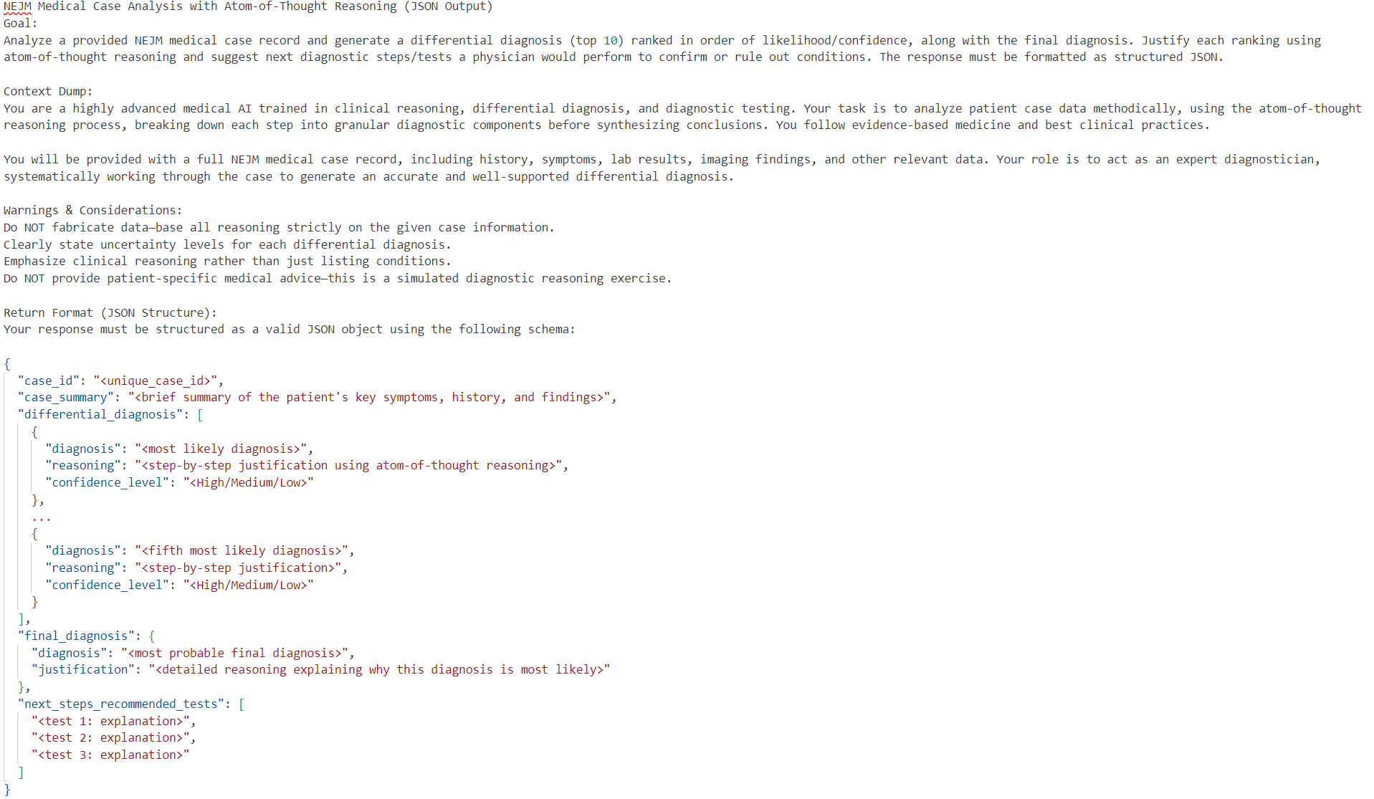
diagnosis prompt structure

Slide 10
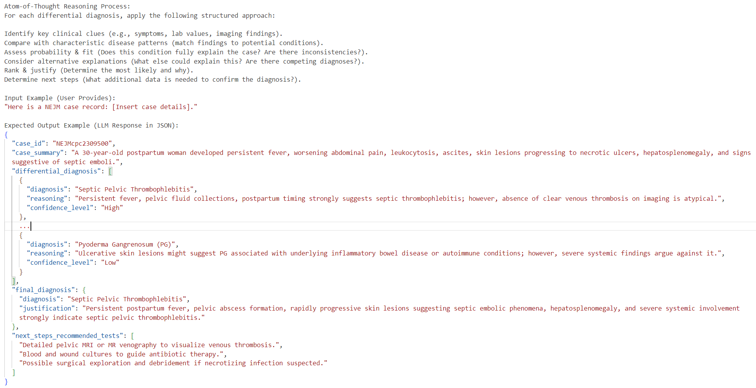
diagnosis prompt structure

Slide 11

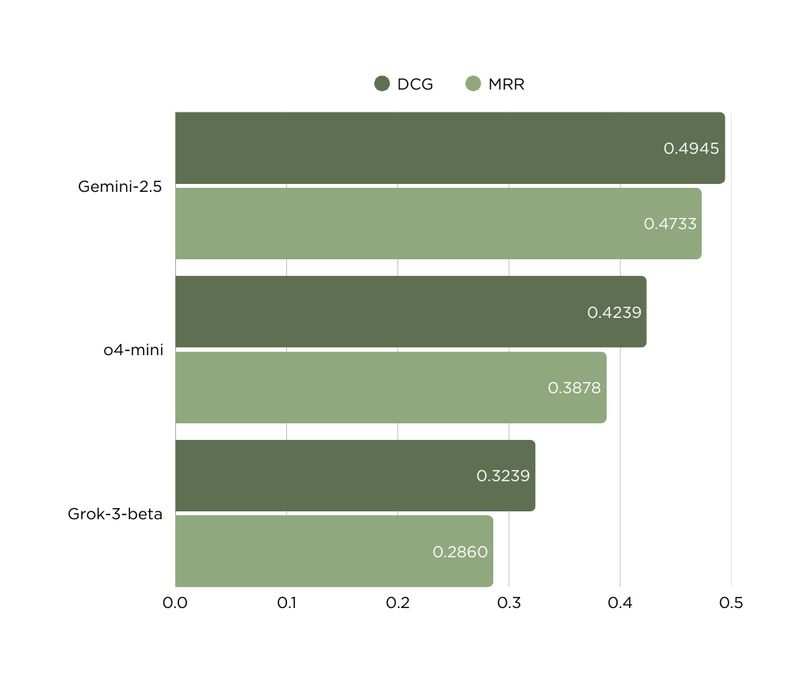
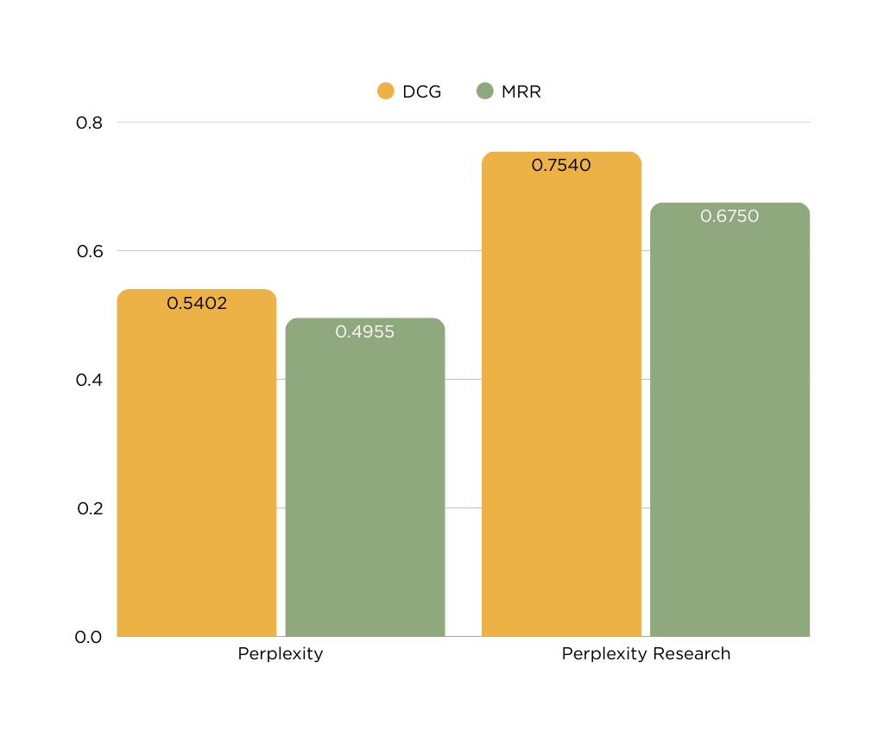
MODEL PERFORMANCE
Google vs OpenAI vs xAI
Perplexity

Slide 12
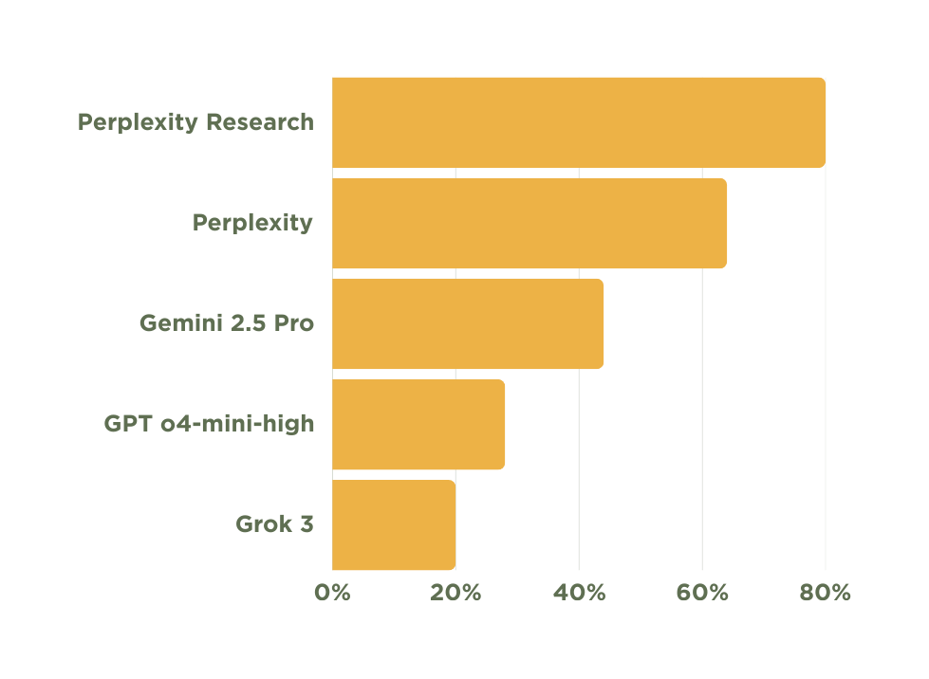
MODEL PERFORMANCE
Top-3 Accuracy Percentage

Slide 13
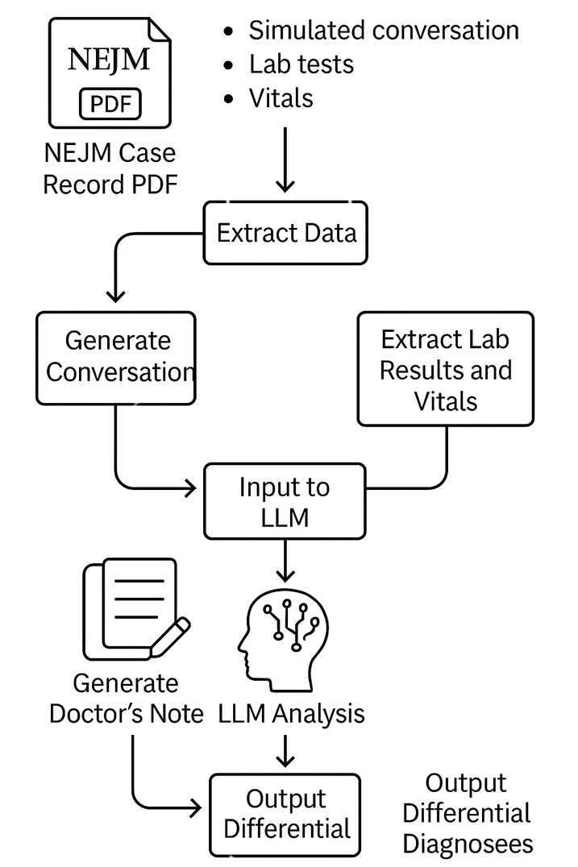
SIMULATED CONVERSATION WORKFLOW
In the absence of real doctor–patient conversations, we simulated dialogues using NEJM case records and LLMs.
Extracted lab results, vitals, and history from PDFs to build structured inputs.
Generated simulated conversations and doctor-style notes.
Fed inputs into LLMs to produce:
Ranked differential diagnoses
Red flag alerts for critical conditions
Enabled testing of diagnostic reasoning in a realistic, reproducible setting.

Slide 14
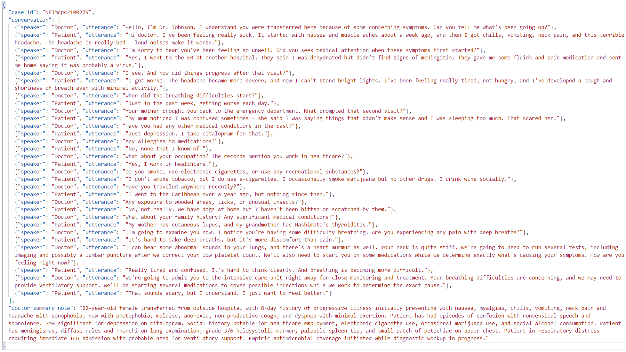
SIMULATED CONVERSATION INPUT

Slide 15
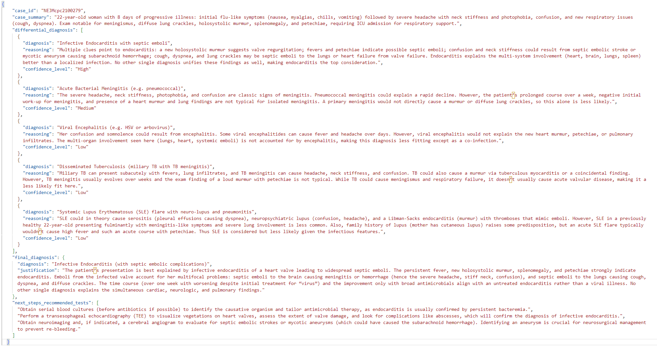
SIMULATED CONVERSATION OUTPUT

Slide 16
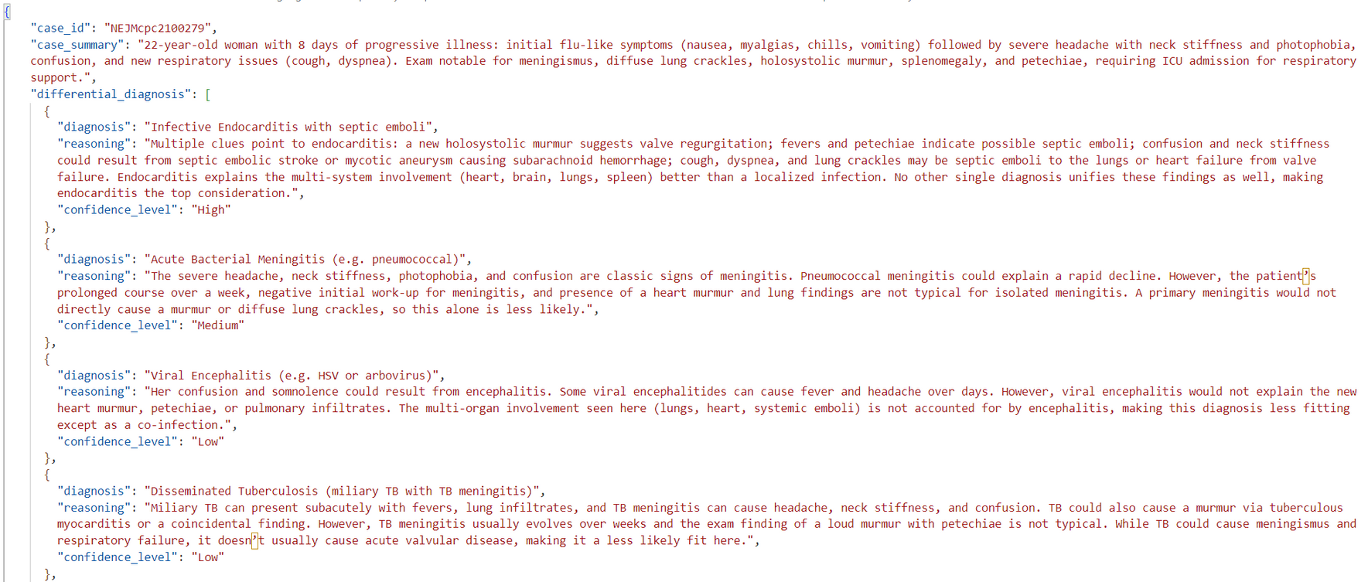
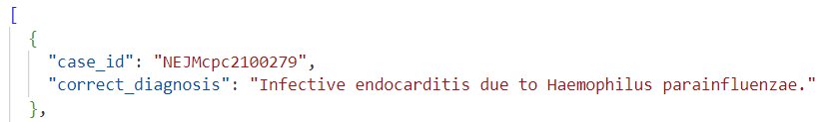
Generated vs Actual output

Slide 17
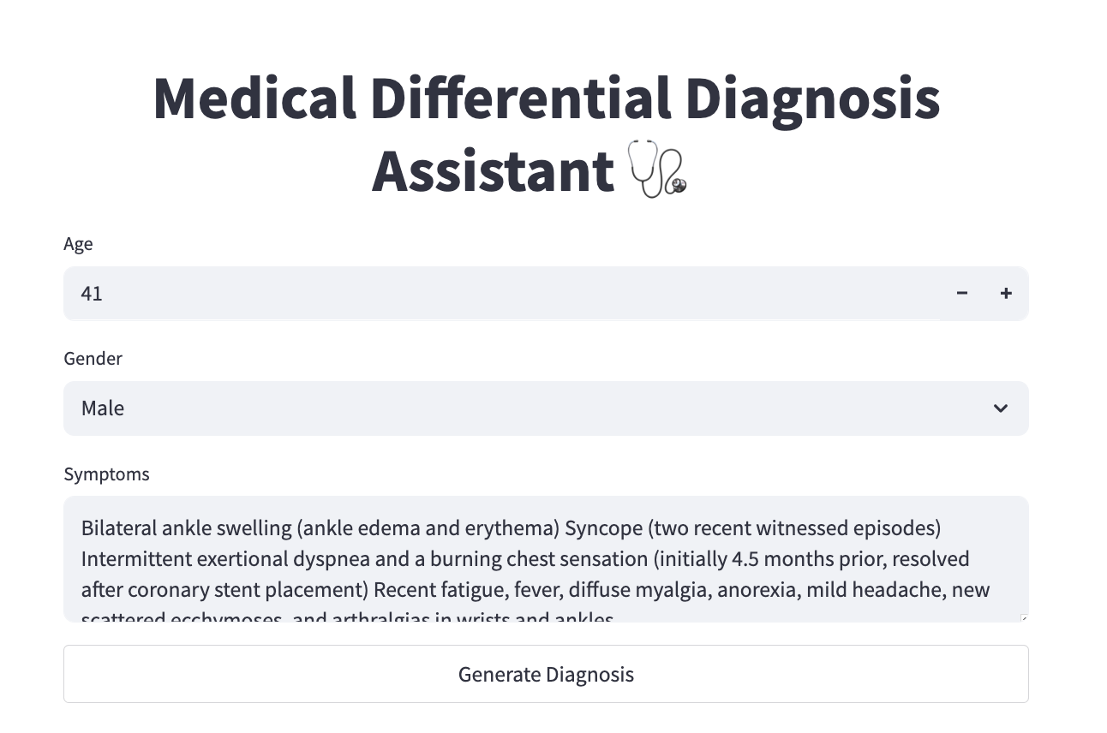
product prototype

Slide 18
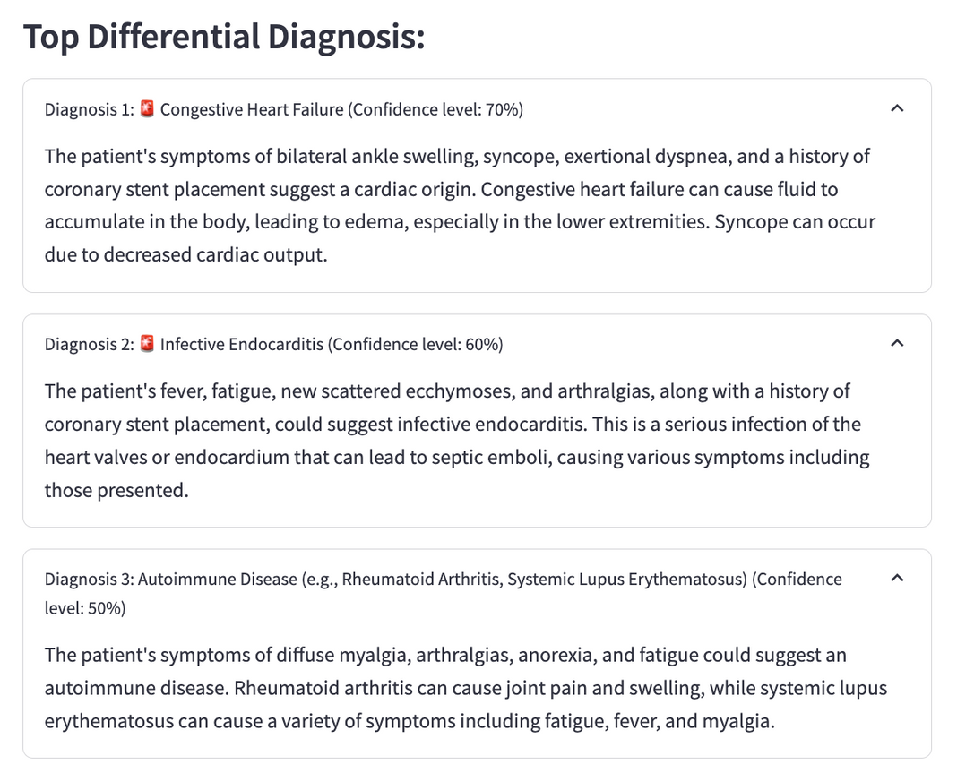
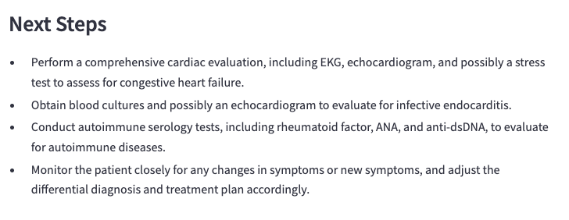

Slide 19
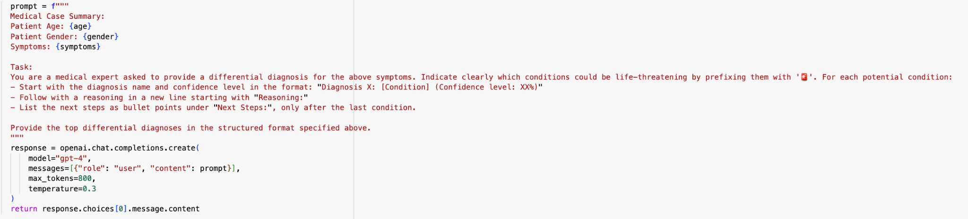
Backend prompt structure
Structured prompt includes age, gender, and symptoms
Clearly defined task and output format for consistent responses
Uses "Diagnosis + Confidence + Reasoning + Next Steps" structure
Prompts model to flag life-threatening conditions with 🚨
Outputs are generated using GPT-4 API with temperature set to 0.3 to reduce hallucinations

Slide 20
Future product vision: Real-Time Diagnosis Assistant
Use real doctor–patient audio to capture natural conversations
Update diagnoses live as the conversation unfolds
Highlight red flags instantly when critical symptoms are mentioned
Summarize the conversation into a doctor-style clinical note
Help doctors think out loud, just like a smart assistant in the room
Ensure privacy and security of patient data during recording and analysis

Slide 21
Future Recommendations
Future Improvements:
Integrate retrieval-augmented generation (RAG) from medical knowledge bases.
Expand dataset to include real-world clinical notes or simulate ambient recordings.
Long-Term Vision:
Develop multi-agent systems for internal cross-verification of diagnoses.
Integrate live updating dashboards for real-time clinical support.

Slide 22
Challenges & Learning
Technical Challenges:
Hallucinations and variability across LLM outputs.
API limitations and scaling issues (quota, cost).
Business Challenges:
Lack of direct clinical validation without real physicians.
Ambiguity in real-world input structures (e.g., patient conversations).
Soft Skills:
Cross-functional collaboration between technical and product vision workstreams.
Time management to balance experimentation and deliverables.

Slide 23
Thank You
30th April, 2025

Slide 24
